Slide 1
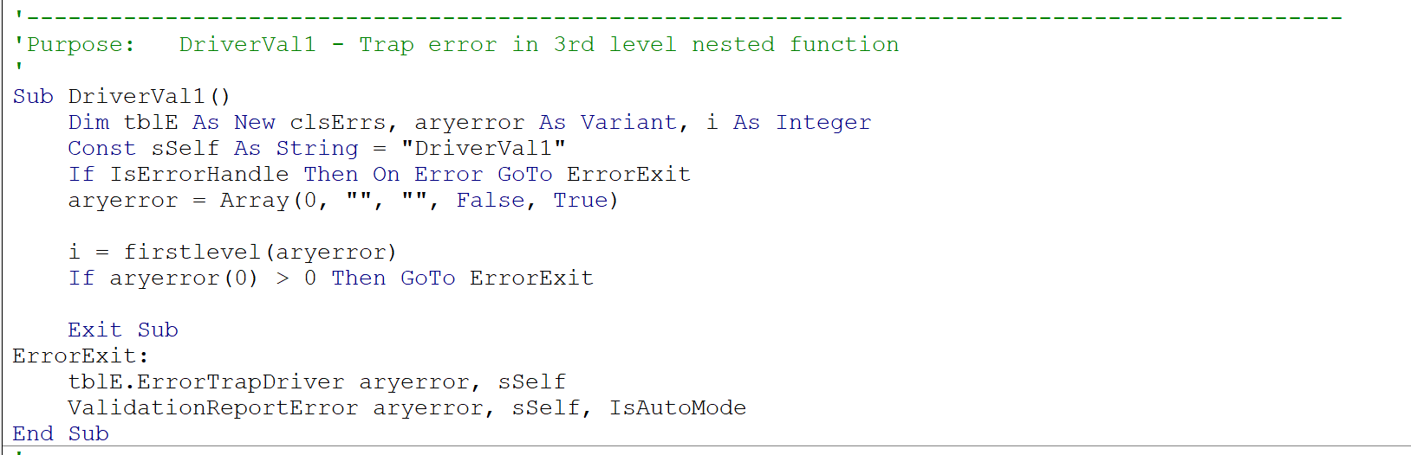
Class Definition declared in routines using clsErrs.ErrorTrapDriver
Constant sSelf providing name as String for each function/sub
aryerror “tuple” initialized in driver subroutine only
Error trapping for function call - aryerror passed as byRef argument
Two-line error trapping for a driver subroutine
(reporting call only needed in top-level sub or function)

Slide 2
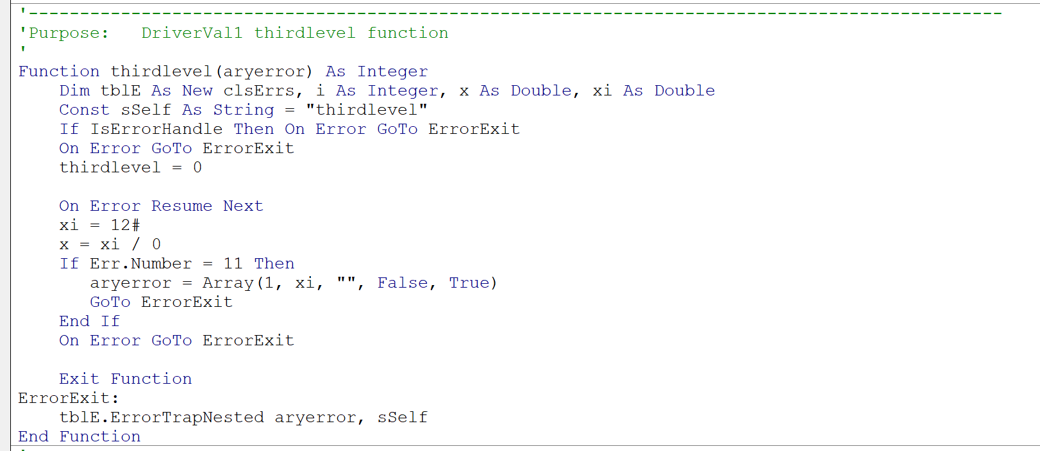
Example error trap – code causes divide by zero error
Error code (Base + 1)
Placeholder for error message lookup by tblE.ErrorTrapNested()
Flag new error
Non-local error since occurs in nested function
Parameter value (xi = 12.0) to report in error message
One-line error trapping for a nested function

